Slide 1
Lecture Module: Recording and Preprocessing EEG Data
George A. Buzzell
Florida International University
George Buzzell does not take credit for any of the images presented in these lecture slides. All images were sourced from materials available from Steven J. Luck, Michael X. Cohen, or identified through generic google image searches. Appropriate credit for all images/figures can be identified through a reverse image search or by requesting this information directly from George Buzzell at gbuzzell@fiu.edu. George Buzzell acknowledges the influence of the EEG books and videos by Michael X. Cohen and Steven J. Luck in creating these lectures.

Slide 2
What preprocessing is and why it is needed

Slide 3
Why is preprocessing needed?
Raw EEG data contains neural data, physiological noise and electrical noise
Data will look cleaner when you record b/c the display filter, but actual raw data looks very messy!
Noise present in raw data:
Large dc offsets
Large drifts
High frequency noise
Line noise
Physiological artifacts: blinks, saccades, EMG
Disconnected channels
Disconnection of the ground/reference

Slide 4
What is preprocessing?
Preprocessing is a common set of algorithms that are applied to most EEG data before performing analyses of interest (“cleaning” the data)
Goal: remove “noise” and isolate brain activity
Preprocessing is cleaning, not analysis (ERPs, spectral analyses)
Good preprocessing is done in a way that anyone can start with the preprocessed data and do their own unique analyses
No epoching, removing as little data as possible (frequencies and channels)
May or may not include labelling

Slide 5
Our Standard Preprocessing Pipeline
Goal was to establish a common EEG preprocessing pipeline
MATLAB/EEGLAB code
Automated to improve objectivity/reproducibility
Allow for easy (re)analysis across sites and time points

Slide 6

Pipeline Overview
Identification and removal of bad electrodes
High/low-pass filter
Pre-ICA artifact removal
Make copy of data, aggressively clean and run ICA
Copy ICA weights back to original data
Semi-automated ICA-artifact detection/removal
Channel interpolation
Compute average reference
Result is cleaned data, pre-epoched
After epoching, we perform a final rejection of bad epochs

Slide 7
Part 3: Specific Preprocessing Steps

Slide 8
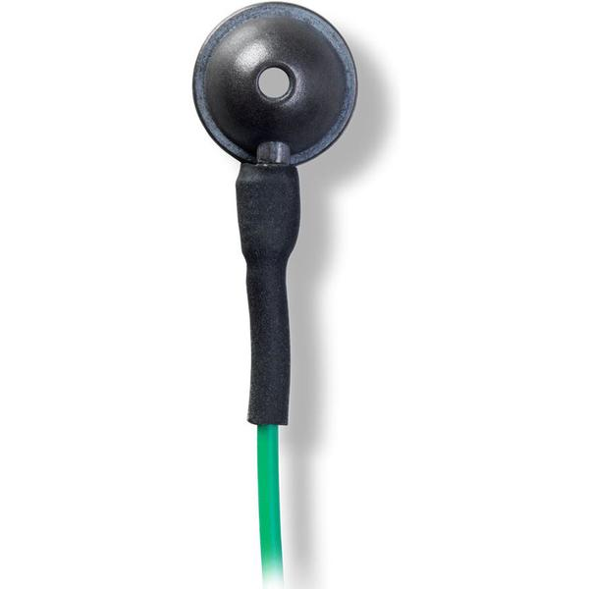
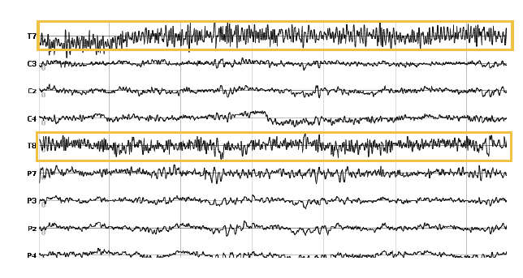
Remove bad Electrodes
Need to determine which electrodes are too noisy
Result of poor connection, faulty electrode, or excessive muscle/physio artifact
FASTER has an algorithm for detecting “bad channels”
Based on correlation of nearby channels
Probability of data based on prior data
Hurst exponent (frequency spectrum of bio data)

Slide 9
Filter Data
Time domain signals are a combination of different frequencies
We can use filters to remove frequencies that are not likely to contain brain activity
Low-pass filter (pass low frequencies we want) < 50 Hz
High-pass filter (pass high frequencies we want) > .3 Hz

Slide 10
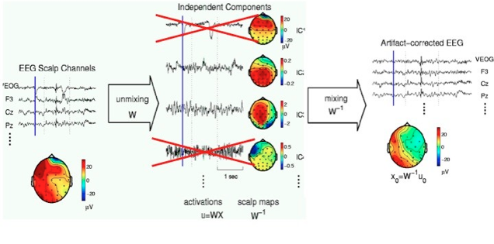
Independent Components Analysis (ICA)
ICA identifies n independent components equal to n sources of data (channels)
Allows us to model and remove physiological noise (blinks, saccades, EMG)

Slide 11
Preparing for ICA
The ICA decomposition is sensitive to non-stationarity in the data
Slow drifts, Muscle artifact
Can remove slow drift with high-pass filter (1Hz)
Can remove muscle artifact by cutting out those portions of the data
These “solutions” change the data and yield less of it

Slide 12
Alternative approach to preparing for ICA
Use approach created by Debner and colleagues
Make copy of data
High-pass filter at 1 Hz
Epoch into arbitrary 1-s epochs
Automated rejection of noisy epochs
+/- 1000 microvolts
+/- 30 db in 20-40 hz (emg)
Run ICA on copied-cleaned data
Get ICA weights from the copied-cleaned data and copy these back to original dataset
Why do we run ICA on a copy?
Allows us to improve ICA via filter/cleaning, but still have data we can analyze with lower frequencies

Slide 13
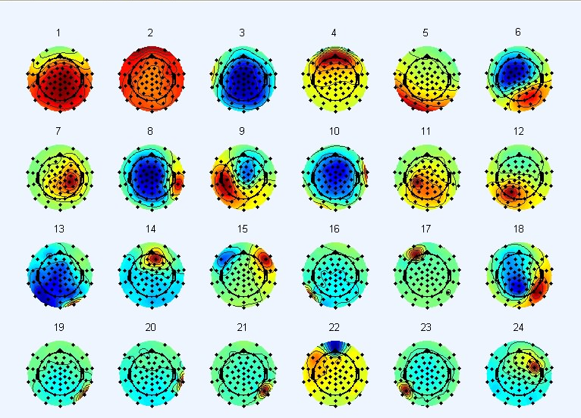
ICA Results

Slide 14
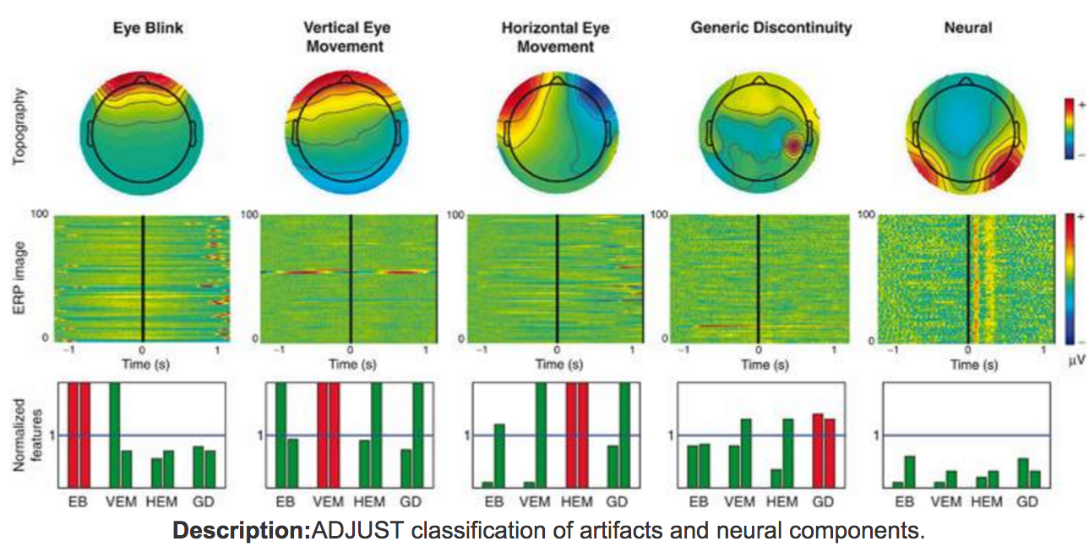
Identify/Reject Artifact-ICA
ADJUST automatically detects artifact-ICA components
Always double-check results!
Select/remove artifact components

Slide 15
Interpolate missing channels
We rejected bad channels and need to now interpolate them
Spherical spline interpolation
Basically, models the whole head, instead of just using nearby electrodes

Slide 16
Re-reference
One common approach is to use the mastoids as the reference
You are distorting what you can see, but everyone uses the same distorted images, so they are comparable across labs
The other option is to use an average reference
The average of all other channels is used as the reference
If you perfectly measured the entire volume, this would be ideal…
Benefit of an average reference is that you are not missing any data
Downsides are that you don’t meet true assumptions for average reference and it may be more difficult to compare your data to others
Use average reference, but understand limitations and be familiar with the other most common reference: mastoid reference

Slide 17
Additional steps (technically not preprocessing)
Label data
Find markers of interest, add additional fields of interest
Over-label! Never know what will be interesting later
Epoch data
Correct marker timing offsets before epoching
Find markers of interest and cut data around markers
Size of epochs may differ for Fourier vs. ERPs vs. TF

Slide 18
Stimulus presentation and response recording
When stimuli are presented, or responses recorded, a timing marker is sent to EEG file
Allows us to match cognitive event to neural recording
There is ALWAYS a non-zero error in the timing of these markers*
Timing offset is unique for stimulus onset and recording
Separately influence stim-locked vs. response-locked markers
Critical to minimize and correct for these offsets
A systematic (constant) offset is not a big issue, can measure/correct
A variable and unpredictable offset is a very big issue and must be fixed
Measure/record timing offsets monthly for quality control

Slide 19
Final Rejection
After epoching your data, perform a final rejection of epochs that contain artifacts
It is common to still have some residual blink artifact not captured by ICA removal
Never assume that ICA is working perfectly… critical to perform a final rejection
One based on ocular
Additional rejection/interpolation for all other channels

Slide 20
Questions?
Any questions about:
What preprocessing is, why needed?
Specific preprocessing steps?
Next up is “Hands-on module: Preprocessing EEG data”

